Slide 1
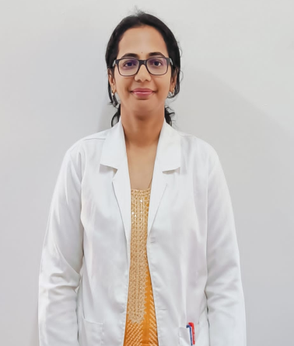
Dr. Kruthi B N
MBBS, MD (Biochemistry)
Associate Professor in
Dept. of Biochemistry Sri Chamundeshwari Medical College Hospital & Research Institute , Channapatna
drkruthibn@gmail.com

Slide 2
EDUCATIONAL QUALIFICATION
Qualification | Institute | University | Year of completion
MBBS | Hassan Institute of Medical College, Hassan | RGUHS | 2012
MD Biochemistry | Mandya Institute of Medical Sciences, Mandya | RGUHS | 2016

Slide 3
WORK EXPERIENCE
Position | Period | Institution
Tutor | 31.08.2013 to 30.08.2016 [3Yr] | MIMS, Mandya
 | 09.05.2017 to 13.11.2019 [2Yr,6mon] | MIM, Mandya
Assistant Professor | 14.11.2019 to31.08.2023 [3Yr,9Mon] | AIMS,B G Nagar
 | 01.09.2023 to 12.11.2023 [2Mon,15 Days] | Sri Chamundeshwari Medical College Hospital & Research Institute, Channapatna
Associate Professor | 15.11.2023 to till date | Sri Chamundeshwari Medical College Hospital & Research Institute, Channapatna

Slide 4
Publications
1)Association of Serum Calcium Uric Acid Level With Inflammatory Markers To Predict the outcome Of COVID-19 Infection : A Retrospective Study.
2) Role of Triglyceride Glucose Index And Other Triglyceride in Predicting metabolic Syndrome among Medical Students in Karnataka : A Cross –Sectional Study.
3)Use of Dried Blood Spot As An Alternative Method to Estimate Serum Triglyceride in Field Studies. Liver Enzyme As Predictors of Risk of Diabetes Among First Degree Relative of Type 2 Diabetes Patients.
4) A Comparative Study To Determine The predictor of Renal Impairment in Essential Hypertensive Patients.
5)Liver Enzymes As Predictors of Risk Of Diabetes Among First Degree Relative Of Type-2 Diabetes Patients.

