Slide 1
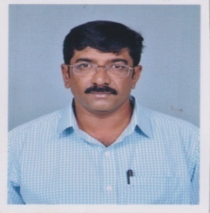
Dr. Swaroop B.P
MBBS, MD (Physiology )
Assistant Professor in
Dept. of Physiology, Sri Chamundeshwari Medical College Hospital & Research Institute , Channapatna
drswaru77@gmail.com

Slide 2
EDUCATIONAL QUALIFICATION
Qualification | Institute | University | Year of completion
MBBS | Adichuchanagiri Institute of Medical College, | Mysore | 2004
MD Physiology | Adichuchanagiri Institute of Medical College, | RGUHS | 2013

Slide 3
WORK EXPERIENCE
Position | Period | Institution
PG Cum Tutor | 2010 to 2013 | Adichuchanagiri Institute of Medical College,
Tutor | 31.05.2013 to 18.03.2024 | Mandya Institute of Medical Sciences'
Assistant professor | 03.04.2024 to till date | Sri Chamundeshwari Medical College Hospital & Research Institute, Channapatna

